Slide 1



CMU Forum
title
search
Home
Hot Topics
User_name
logout
Favourite sessions
Housing | Provide information about house sublease and rent | Moderator: zruan
Course | Discussion about courses information | Moderator: bowenz
Life in Pittsburgh | What is the life in Pittsburgh | Moderator: linxz
Pet | Share your friends about your friends | Moderator: zruan
Forum sessions
Life in Pittsburgh | Moderator: zruan
Threads today: 20
Work | Moderator: linxz
Threads today: 50
Study in CMU | Moderator: bowenz
Threads today: 15
Secret words | Moderator: linxz
Threads today: 25
Technology | Moderator: bowenz
Threads today: 10
Entertainment | Moderator: zruan
Threads today: 25
Other Important Information
Notes:
This is the homepage of our Forum, the first block is the sessions the user likes and he can manually define it, the second block is the top layer of sessions in the Forum.

Slide 2
CMU Forum
user
search
Home / HotTopics
Hot Topics
User_name
logout
No. | Title | Session | Author | Reply | Click
1 | Companies in TOC ! | Work | linxz | 35 | 430
2 | Where can I find a good restaurant? | Food | Bob | 32 | 350
3 | Party at Halloween ~~ | Entertainment | zruan | 29 | 332
4 | Ipad pro v.s. Surface pro | Technology | Tehiccc | 29 | 312
5 | XXXXXXX | S4 | User4 | 28 | 311
6 | XXXXXXXXXXX | S5 | User5 | 27 | 310
7 | XXXXX | S6 | User6 | 26 | 309
8 | XXXXXXXXXXXXXXXXX | S7 | User7 | 25 | 308
9 | XXXXXXXXX | S8 | User8 | 24 | 307
10 | XXXXX | S9 | User9 | 23 | 306
Other Important Information
Notes:
This is the top ten hot topics in one day

Slide 3



CMU Forum
title
search
Home / Life in Pittsburgh / Food
Hot Topics
User_name
logout
Reply: 32 | Where can I find a good restaurant? Oct. 13 20:48
|topic:12|score:247| Bob Titles | I just want to find a good restaurant ! Here I also prepare a vote section so we can all view the distribution of yummy food ! Squirrel Hill ShadySide Craig. Street Other
|topic:12|score:24| Lin Titles | Hi, I’ve tried several restaurants near Pittsburgh University, I think it’s a great place !
|topic:12|score:24| Yu Titles | Agree with the above floor, why not add a selection of “Pittsburgh campus” ~~
submit
Only this author
Oct. 13 21:30 1st Floor
Reply
Oct. 13 21:45 2st Floor
Reply
Notes:
This is what a topic looks like, there are title, main topics and everyone inside of the topic would reply to the person creates the topic.

Slide 4
CMU Forum
title
search
Home / mails
Hot Topics
User_name
logout
Title | From | Time
Hello, nice to meet you ! | bowenz | Oct. 12 22:43
Hey, can you tell us more about your experience at TOC ? | linxz | Oct. 12 13:25
Good morning ! There is a Halloween party ! | zruan | Oct. 11 9:48
Welcome to the food session ! You can explore more on this world here ~~ | Fooder | Oct. 9 22:23
XXXXXXXXXXXXXXXXXXXXXXXXXXX | UUUU | TTTTTTTTTTTTT
XXXXXXXXXX | UUUU | TTTTTTTTTTTTT
XXXXXXXXXXXXXXXXX | UUUU | TTTTTTTTTTTTT
XXXXXXXXXXXXXXXXXXXXXXXXXXXXXXXXXXXXXXXX | UUUU | TTTTTTTTTTTTT
XXXXXXXXXXXXXXXXXXX | UUUU | TTTTTTTTTTTTT
XXXXXXXXXXXXXXXXXXXXXXXXXX | UUUU | TTTTTTTTTTTTT
1 2 3 … 10 Go
Notes:
This is the short message (mail) looks like, the unread message would show in bold font.

Slide 5
CMU Forum
title
search
Home / mails
Hot Topics
User_name
logout
bowenz | Hello, nice to meet you !
user_name | Nice to meet you, too !
bowenz | I’ve looked at your reply on the TOC topic, and I wonder whether I can ask for some questions relation to that ?
user_name
reply
Notes:
This is what we use to view and reply messages

Slide 6



CMU Forum
user
search
Home / Travel
Hot Topics
User_name
logout
All Topics| Votes | Images | Events |
Title | Author | Reply | Click | Last Reply
[Event]3-Day Trip to LAX! | linxIz | 35 | 430 | 13:20
[Event]Spend X-mas in Florida~ | Bowen | 32 | 350 | 8:00
[Event]Thanks Giving to New York~~~ | linxiz | 29 | 332 | 10/5/2015
[Vote]How to Spend this Weekend? | zruan | 29 | 312 | 10/2/2015
[Image]My Weekend at New York | User0 | 28 | 311 | 9/31/2015
Travel Tips to New York | User1 | 24 | 307 | 09/10/2015
LAX Traveler Tips | User2 | 23 | 306 | 08/11/2015
1 2 3 … 10 Go

Slide 7
CMU Forum
user
search
Home / Travel
Hot Topics
User_name
logout
All Topics| Votes | Images | Events |
Title | Author |  | Reply | Click | Last Reply
How to Spend this Weekend? | zruan |  | 35 | 430 | 10/2/2015
XXXXX | User3 | 26 |  | 309 | 9/21/2015
XXXXXXXXXXXXXXXXX | User4 | 25 |  | 308 | 6/1/2015
XXXXXXXXX | User5 | 24 |  | 307 | 2/23/2015
XXXXX | User6 | 23 |  | 306 | 1/3/2015
1 2 3 … 10 Go

Slide 8

CMU Forum
user
search
Home / Travel
Hot Topics
User_name
logout
All Topics| Votes | Images | Events |
Title | Author | Reply | Click | Last Reply
[Image]My Weekend at New York | User0 | 28 | 311 | 9/31/2015
[Image]Long Weekend at Washington D.C. | User7 | 24 | 307 | 9/11/2015
[Image]XXX | User8 | 23 | 233 | 2/28/2015
[Image]XXXXX | User9 | 213 | 2333 | 1/31/2015
1 2 3 … 10 Go

Slide 9
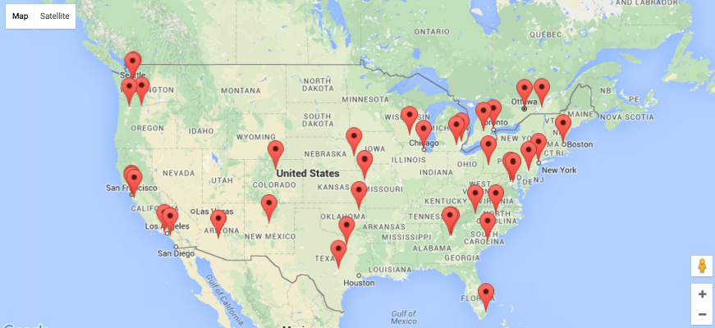
CMU Forum
user
search
Home / Travel
Hot Topics
User_name
logout
All Topics| Votes | Images | Events |
Title | Author | Reply | Click | Last Reply
[Event]3-Day Trip to LAX! | linxIz | 35 | 430 | 13:20
[Event]Spend X-mas in Florida~ | Bowen | 32 | 350 | 8:00
1 2 3 … 10 Go

Slide 10

CMU Forum
Hot Topics
Home / XXX / XXX (path)
User_name
logout
Profile | Friends | Collections | Activities |
ID: King_of_LTI
Email: king@lti.cs.cmu.edu
Department: LTI
Gender: Male
Date of Birth: 11/21/1991
User Group: Level 1
Bio: I’m more handsome than Jamie!
Edit
Threads: 32
Posts: 256
Votes: 21
Events: 5
Join in time: 10/01/2015
Last visit time: 10/15/2015

Slide 11
CMU Forum
Hot Topics
Home / XXX / XXX (path)
User_name
logout
Profile | Friends | Collections | Activities |
ID: King_of_LTI
Email: king@lti.cs.cmu.edu
Department: LTI
Gender: Male Female
Date of Birth: 11/21/1991
User Group: Level 1
Bio: I’m more handsome than Jamie!
Save
Threads: 32
Posts: 256
Votes: 21
Events: 5
Join in time: 10/01/2015
Last visit time: 10/15/2015

Slide 12
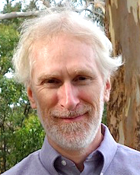
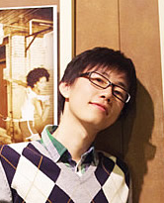
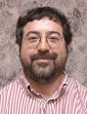

CMU Forum
Hot Topics
Home / XXX / XXX (path)
User_name
logout
Profile | Friends | Collections | Activities |
Brother Jamie
Big Beer God
Nyberg mei wo shuai
Wo shi 09 gei wo zhong
Unfollow
Unfollow
Best Teacher
Love Island Rice
You can you up, no can no bb!
2333333333333
Unfollow
Unfollow

Slide 13
CMU Forum
Hot Topics
Home / XXX / XXX (path)
User_name
logout
Profile | Friends | Collections | Activities |
Title
Forum
Views/Replies
100 ways to earn 1 billion $ in a day
Life
891/56
Nyberg is a good teacher!!!!
Study
1001/123
Shadyside House, 100$/mon
House Rent
12/1
Looking for people go japan this summer
Trip
231/22
1 2 3 … 10

Slide 14
CMU Forum
Hot Topics
Home / XXX / XXX (path)
User_name
logout
Profile | Friends | Collections | Activities |
User
Lin Nan
Action
Post
Filter
E
Brother Jamie will attend the event Free Food in GHC
3min ago
V
Brother Jamie voted for the question Who is the best teacher in LTI?
10min ago
P
Lin Nan posted a new thread Wang Yan wo cuo le, bie sheng qi le.
2h ago
R
ZhaZha posted a reply for Web development is pretty hard!
1day ago
1 2 3 … 10

